Slide 1
An Introduction to Operating Systems

Slide 2
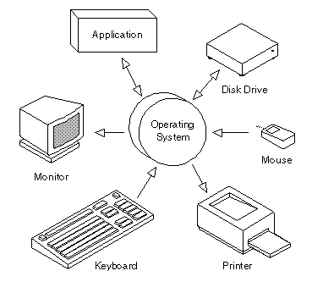
Definition
An Operating System, or OS, is low-level software that enables a user and higher-level application software to interact with a computer’s hardware and the data and other programs stored on the computer.
An OS performs basic tasks, such as recognizing input from the keyboard, sending output to the display screen, keeping track of files and directories on the disk, and controlling peripheral devices such as printers.

Slide 3
UNIX
UNIX was one of the first operating systems to be written, in 1971.
Advantages of UNIX are…
Multitasking – multiple programs can run at one time.
Multi-user – allows more than a single user to work at any given time. This is accomplished by sharing processing time between each user.
Safe – prevents one program from accessing memory or storage space allocated to another program, and enables file protection, requiring users to have permission to perform certain functions, such as accessing a directory, file, or disk drive.

Slide 4
Types of OS
Microsoft Windows
Mainframe
DOS
OS/2
Linux
Mac OS
AmigaOS

Slide 5
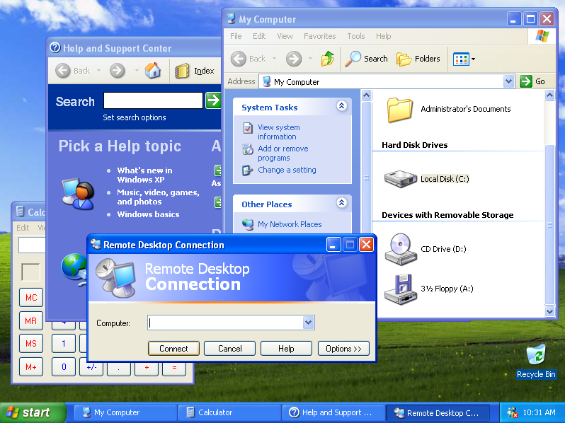
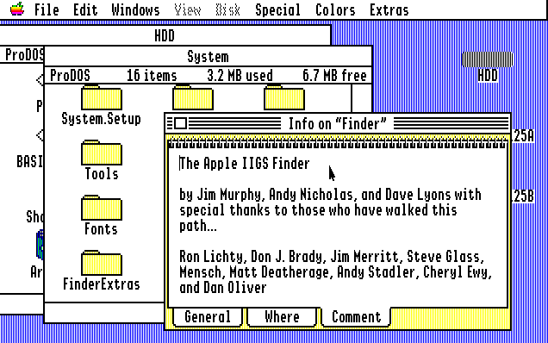
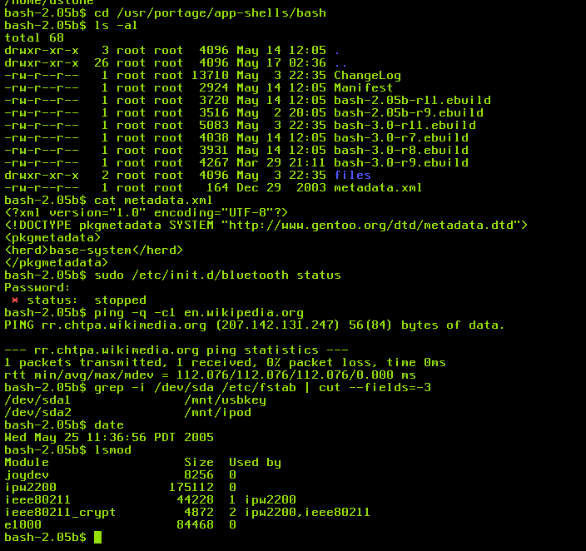
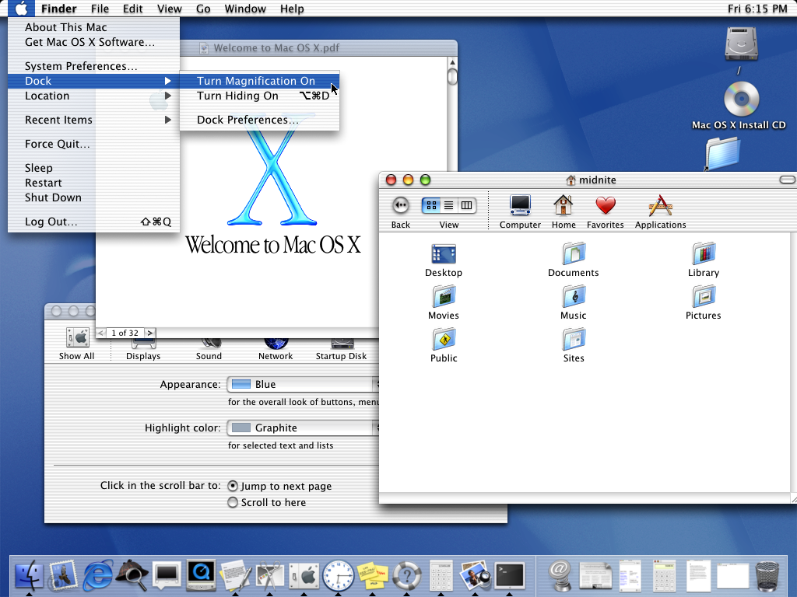
Types Of OS

Slide 6
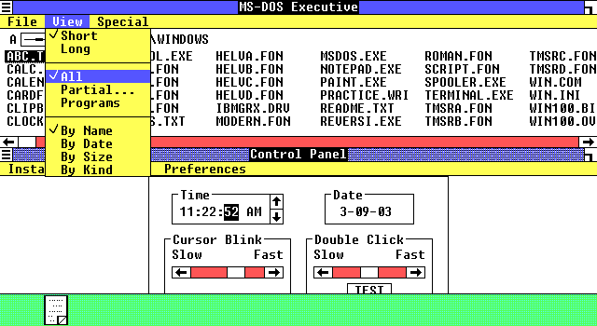
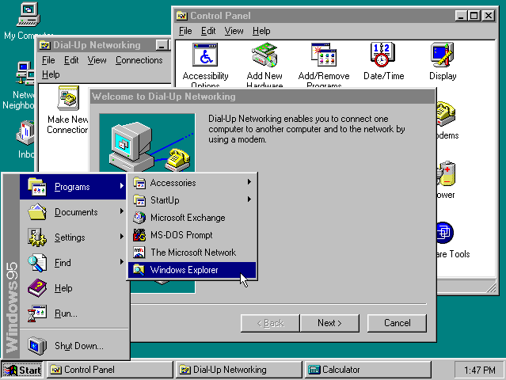
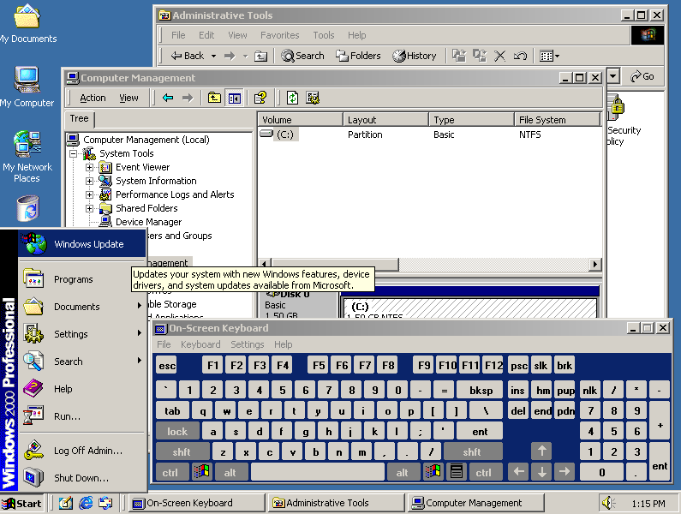
Evolution of Windows

Slide 7
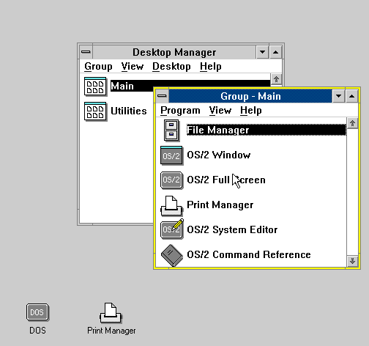
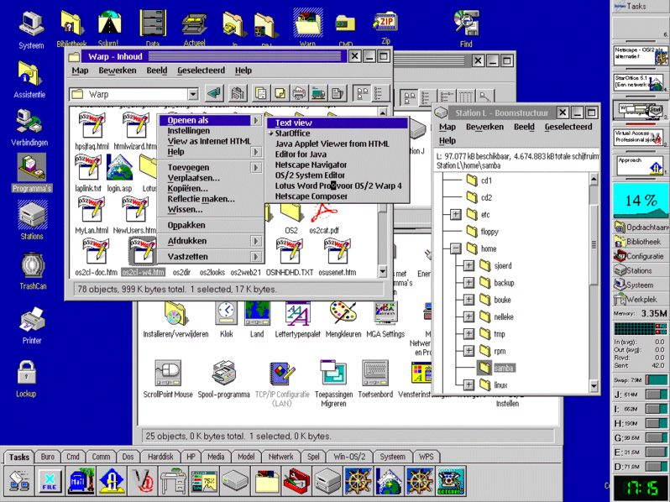
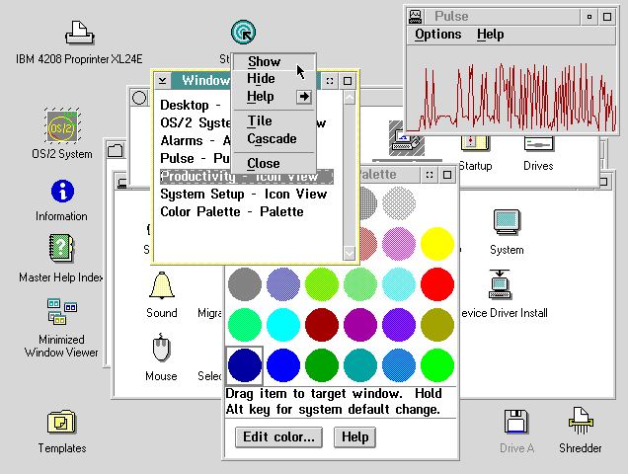
Evolution of OS/2

